Slide 1
COMPUTER NETWORKS
UE20CS253

Slide 2
ICMP PROTOCOL

Slide 3
INTRODUCTION
The Internet Control Message Protocol (ICMP) is a network layer protocol used by network devices to diagnose network communication issues. ICMP is mainly used to determine whether or not data is reaching its intended destination in a timely manner. Commonly, the ICMP protocol is used on network devices, such as routers. ICMP is crucial for error reporting and testing, but it can also be used in distributed denial-of-service (DDoS) attacks.

Slide 4
Purpose of the protocol
The primary purpose of ICMP is for error reporting. When two devices connect over the Internet, the ICMP generates errors to share with the sending device in the event that any of the data did not get to its intended destination. For example, if a packet of data is too large for a router, the router will drop the packet and send an ICMP message back to the original source for the data.
A secondary purpose of ICMP protocol is to perform network diagnostics; the commonly used terminal utilities traceroute and ping both operate using ICMP.
The ICMP echo-request and echo-reply messages are commonly used for the purpose of performing a ping.

Slide 5
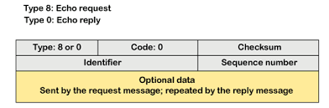
Message format

Slide 6
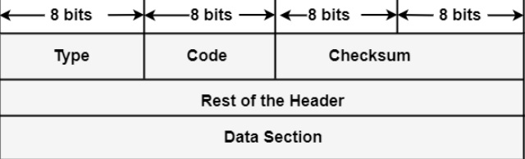
Type: It is an 8-bit field. It represents the ICMP message type. The values area from 0 to 127 are described for ICMPv6, and the values from 128 to 255 are the data messages.
Code: It is an 8-bit field that represents the subtype of the ICMP message.
Checksum: It is a 16-bit field to recognize whether the error exists in the message or not.

Slide 7
Usage of icmp
If one device sends a message that is too large for the recipient to process, the recipient will drop that message and send an ICMP message back to the source.
When the network gateway finds a shorter route for the message to travel on, an ICMP message is sent and the packet is redirected to the shorter route.
Used in Traceroute (display the physical routing path between two internet devices communicating).
Used in Ping.
In distributed DoS (DDoS) attacks, attackers overwhelm the target with unwanted traffic so the target cannot provide service to its users. There are multiple ways an attacker can use ICMP to execute these attacks, including the following:
1) Ping of Death
2) ICMP flood attack
3) Smurf Attack

Slide 8
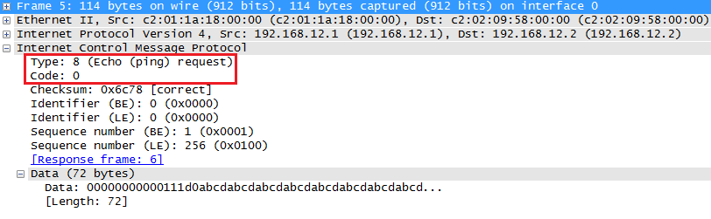
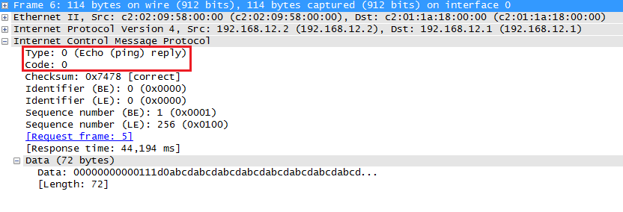
Wireshark captures
ICMP ECHO REQUEST
ICMP ECHO REPLY

Slide 9
CONCLUSION
ICMP is the control sibling of IP
ICMP is used by IP and uses IP as network layer protocol
ICMP is used for ping, traceroute, and path MTU discovery.

Slide 10
THANK YOU
DONE BY:
NAME : VISHWAS M
SRN : PES2UG20CS390
SEC : F
COLLEGE: PES UNIVERSITY(EC CAMPUS)

